Slide 1
Problem Statement Title: Personalized Product Recommendations
Team Name : 686157-U0JI8W33

Slide 2

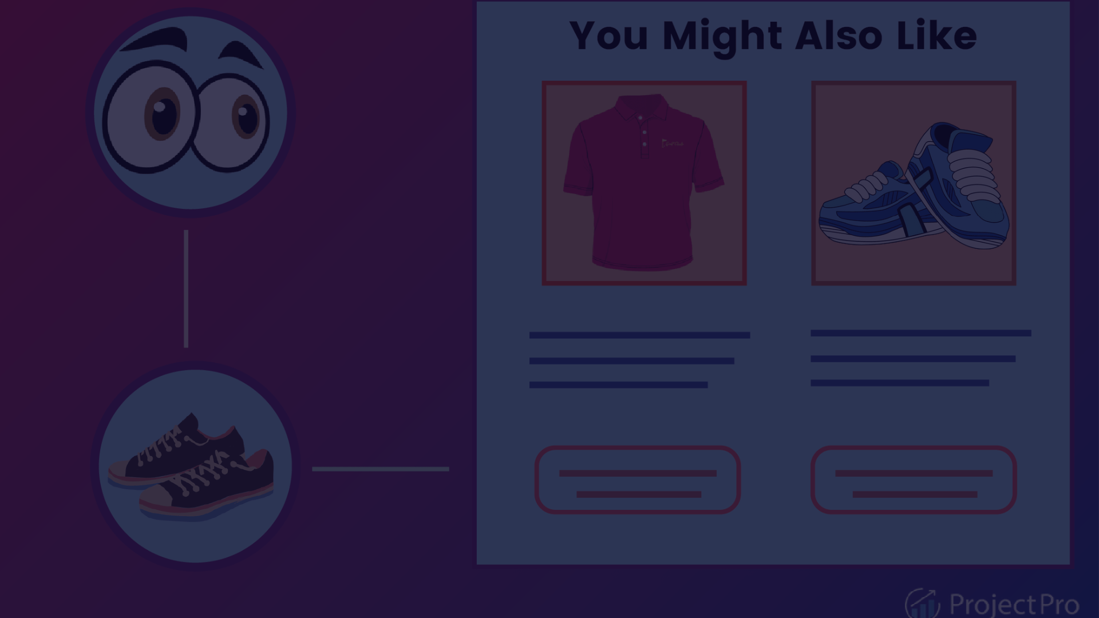
Personalized Product Recommendations
We developed a content-based recommendation system that generates personalized product rankings for each user to enhance e-commerce experiences. The algorithm uses user preferences and history to predict suitable items. Implementation was done in Python using cosine similarity. Sample user data simulated real-world interactions. Performance was evaluated on accuracy and relevance metrics. This presentation covers the techniques used, results obtained, and future optimization scope.

Slide 3

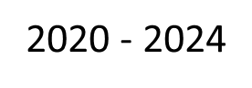
Team Members Details
Team Name | 686157-U0JI8W33
Institute Name/Names | Birla Institute of Technology, Mesra, Ranchi
Team Members > | 1 (Leader) | 2 | 3
Name | Prakhar Kumar Singh | Ankit Ghosh | Sameer Damkondwar
Batch

Slide 4

Deliverables
1
Designed a content-based recommendation algorithm using item similarity
2
Implemented the algorithm in Python to generate personalized rankings
3
Created sample user data to simulate interactions
4
Defined accuracy and relevance metrics for evaluation
5
Provided an end-to-end report on the solution

Slide 5

Expectations
1
Algorithm incorporates user preferences and history
2
Solution predicts suitable products for any user
3
Code generates personalized rankings for each user
4
Metrics help assess prediction performance
5
Discussed strengths and limitations of the approach

Slide 6

Glossary
Content-based recommendation system:
Recommends similar items based on product metadata, descriptions, and attributes.
Personalized ranking:
Customized product rankings tailored for each individual user.
User preferences:
Interests, likes, dislikes indicated by a user.
User history:
Past interactions and purchases of a user..
Cosine similarity:
Metric to calculate similarity between two vectors based on the cosine of the angle between them.
Accuracy metrics:
Metrics like precision and recall to evaluate correctness of model predictions.

Slide 7




Use Cases
Recommending similar products to a customer
Suggesting complementary or accessory products
Personalized landing pages
When a customer views or purchases a particular product, recommend other similar items they may be interested in.
Customize homepage/landing page for each user showing products just for them.
Recommend products that complement or are accessories for items the customer has bought or viewed.

Slide 8

Solution Statement / Proposed Approach
1
Data Preprocessing
Cleaning product metadata like name, description, categories etc..
Applying techniques like lemmatization to normalize data.
2
Building Item Profiles
Combining all text features into a consolidated product metadata field.
Applying TF-IDF vectorizer to create vector representations of each product.
3
Generating Recommendations
Using cosine similarity to find products most similar to the ones users interacted with.
Filtering by attributes like price, discount to improve relevance.
4
Evaluation
Comparing generated recommendations to actual user preferences for accuracy.
Optimization by tuning hyperparameters and evaluation metrics.

Slide 9

Limitations
Reliance on product metadata
No negative signals
Limited personalization
New user cold start
Lack of interaction history for new users leads to generic, non-personalized recommendations.
Recommendations are only as good as the product information available. Limited or low-quality metadata restricts performance.
The current approach only uses positive signals like purchases and views. Dislikes or negative feedback is not incorporated.
Only product interactions of the user are considered. Richer user data like demographics, social connections etc could improve customization.

Slide 10

Future Scope
Real-time Personalization
Dynamically update recommendations in real-time as user interacts with website/app to reflect latest interests.
1
2
3
Location-Based Recommendations
Multi-Device Personalization
Build unified user profiles across devices like mobile, web, tablets for consistent personalized experience.
Incorporate user location context to provide personalized recommendations tailored to where the user is physically at the moment.

Slide 11

Team Members Details
1
Ankit Ghosh
ankitghosh1964@gmail.com
Sameer Damkondwar
2
damkondwarsameer@gmail.com
3
Prakhar Kumar Singh
prakharrathore111@gmail.com

Slide 12
Thank You

